Slide 1
GHNHSFT Covid-19 recovery plan Patient safety and consent concerns
July 2020
REACH presentation to Glos HOSC – 14 July 2020 - © REACH

Slide 2
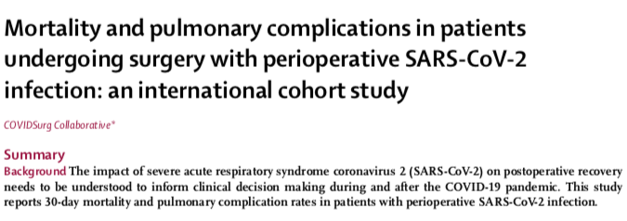
20% of elective surgical patients, who get Covid-19, die within 30 days
REACH presentation to Glos HOSC – 14 July 2020 - © REACH

Slide 3
Safety concerns
Continuation of major elective surgery at GRH against national advice, when a Covid-free site and ITU is available at CGH
Illogical transfer of arterial vascular surgery from CGH to GRH
Potential mixing of elective and emergency surgical patients on Levels 2 & 5 in GRH Tower Block
Removal of emergency theatre at CGH, necessitating transfer of elective CGH surgical patients with complications to GRH
ALL POTENTIAL RISK FACTORS FOR NOSOCOMICAL COVID-19 (HOSPITAL ACQUIRED) INFECTION
REACH presentation to Glos HOSC – 14 July 2020 - © REACH

Slide 4
REACH Survey - > 513 respondents in 3 weeks
97% of all respondents said that it was important to be made aware of COVID risks during surgery
Only 28% of patients (had surgery or on W/L) have been informed about the risks of surgery during COVID – FAILURE OF CONSENT
Only 29% of respondents said that GHT had separated elective and emergency facilities satisfactorily
Only 28% of patients currently on waiting list would have elective surgery during COVID, if fully informed
Only 17% of respondents would be prepared to have elective surgery at a hospital which has been designated as a receiving hospital for COVID patients, if fully informed
REACH presentation to Glos HOSC – 14 July 2020 - © REACH

Slide 5
Suggested temporary actions in Covid-19 recovery
Transfer all elective/planned surgery to CGH
Institute robust consent policy for all surgical patients during Covid-19 pandemic
Reopen emergency theatre at CGH
These actions will alleviate bed pressures at GRH and optimize patient safety during these difficult times.
REACH presentation to Glos HOSC – 14 July 2020 - © REACH

